Slide 1
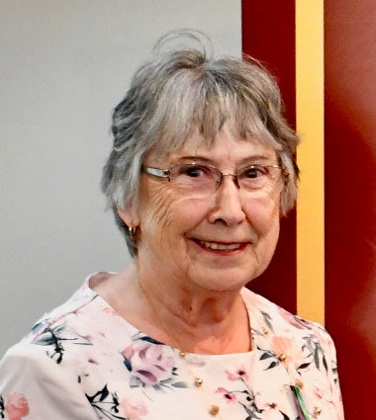

Since 1923 the Foundation has given to:
International Service Projects:
US$19.2 million to benefit women and girls in 35 countries
International Violence Against Women Projects:
US$9.5 million to support families in 46 countries.
Ann Horrocks Zonta Club of Bendigo Inc
Notes:
An important aspect of Zonta is its Foundation supporting all the Service and Educational projects undertaken.
When I joined in 1988 a major project was Water Wells in Sri Lanka. This enabled the women to have access to safe drinking water rather than walking for up to 6 hours per day to provide for their families.

Slide 2
2020-2022 Fundraising Goal is US$4.8M to meet the Service Programs and Educational awards.
Clubs are requested to donate to the Foundation about 30% of charity funds raised to cover the biennial goals.
2 Current Service Projects are:
Notes:
All international Service programs are undertaken with an accredited agency mainly the UN.
This biennium the foundation is supporting 4 major programs two of which I will feature here.

Slide 3
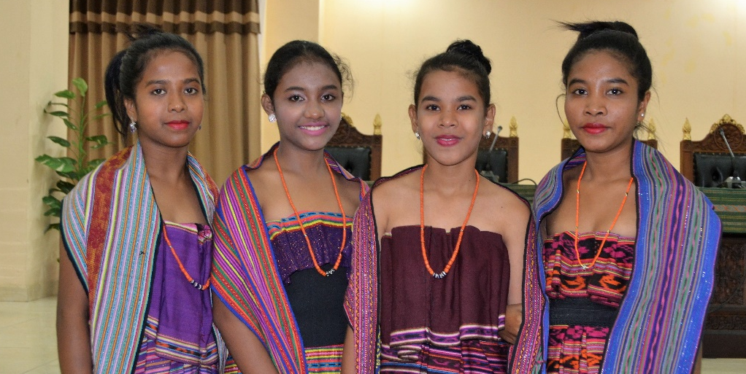

Delivering Survivor-Centered Response to Gender-Based Violence Survivors in Papua New Guinea & Timor-Leste
©UNFPA
Goal:
All women and girls in Papua New Guinea (PNG) and Timor-Leste live life free from violence.
Currently the prevalence of intimate partner violence in PNG is 68% and in Timor-Leste 59%.
The project will assist over 418,000 in PNG and over 100,300 in Timor-Leste
Commitment: US$1 million
Notes:
Firstly an agenda based program in PNG and Timor Leste where currently the prevalence of intimate partner violence in PNG is 68% and in Timor-Leste 59%.
In Timor-Leste, 3 out of 4 women and men believe a man is justified in physically beating his wife.
This project will bring an effective response to Gender Based Violence to these two countries.

Slide 4
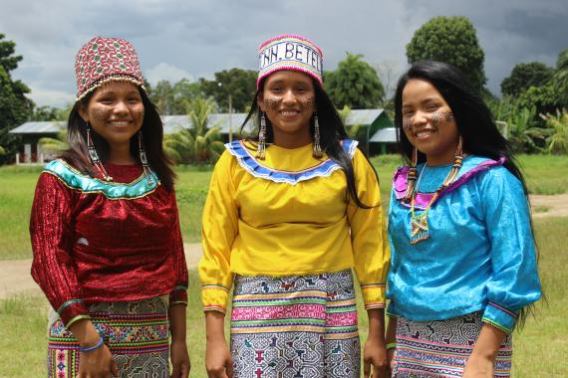

Adolescent Girls’ Health & Protection in Peru
Goal:
Improve the response to the health needs of adolescents especially girls experiencing violence in schools.
Provide quality, adolescent care focusing on mental health care.
The project will assist over 31,000 adolescents (about 15,230 girls)
• 100 health personnel from 10 health care establishments
• 72 principals and teachers in 24 schools
• 14,000 families of adolescent beneficiaries
© UNICEF Perú/Moreno
Commitment: US$1 million
Notes:
Adolescent Girls’ Health and Protection in Peru is Zonta’s second new initiative.
This project seeks to guarantee the rights of indigenous and rural adolescents, especially girls, and respond to their needs by preventing pregnancy, addressing mental health concerns and providing protection from violence.
This project focuses on girls between the ages of 12-17

Slide 5
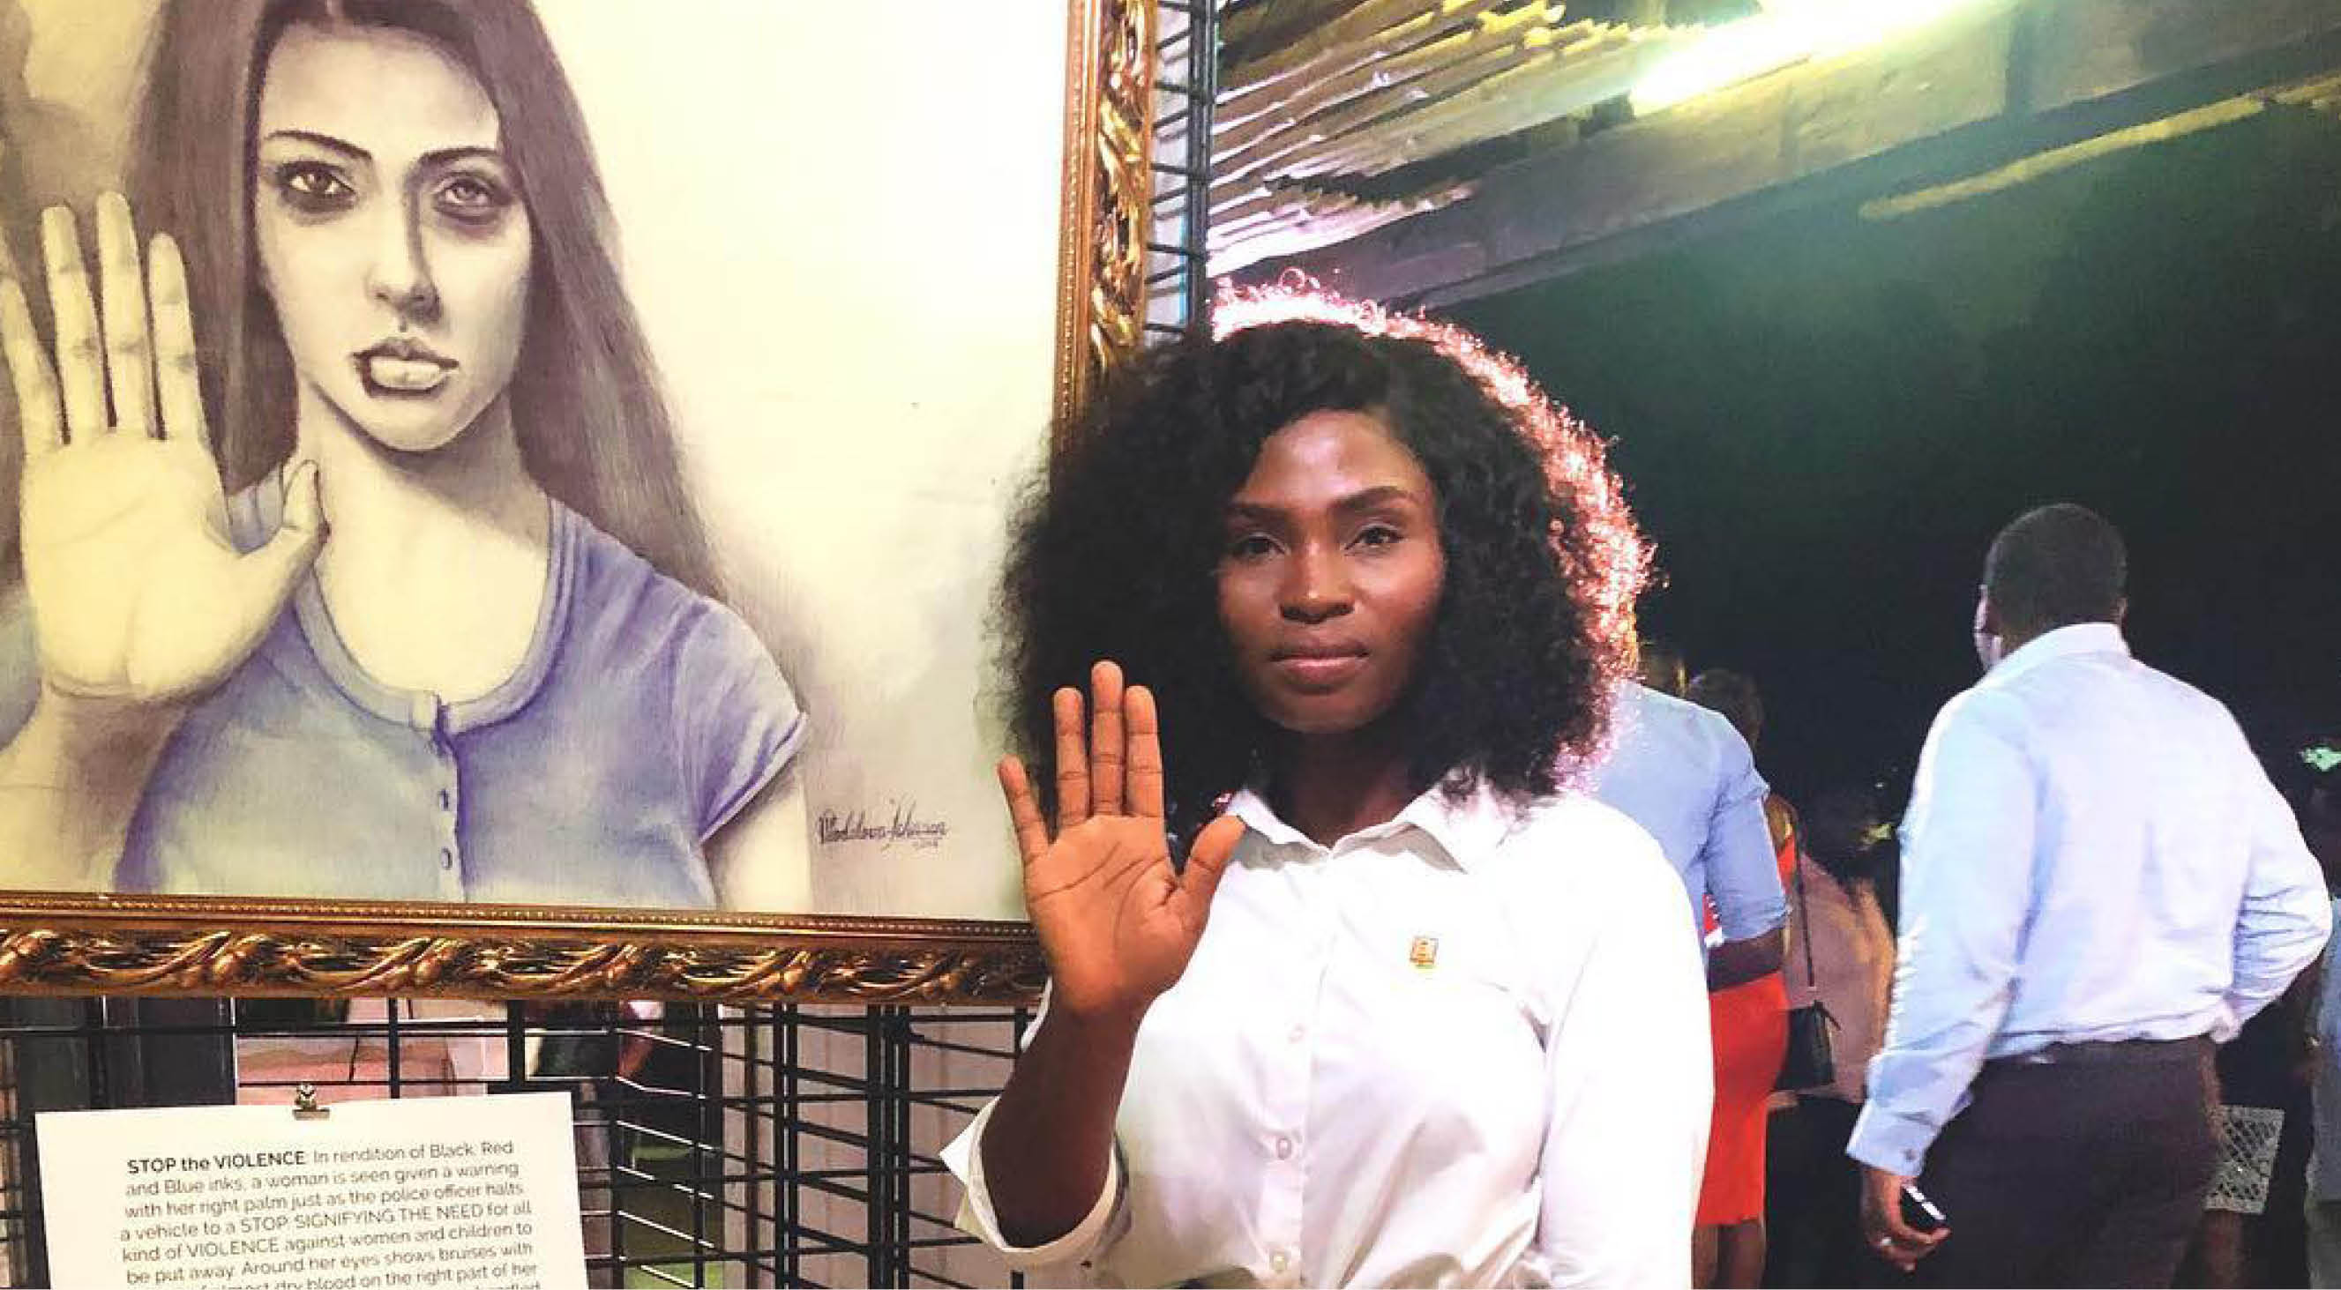
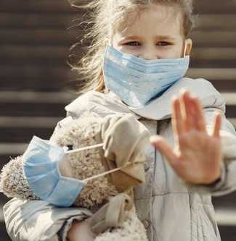
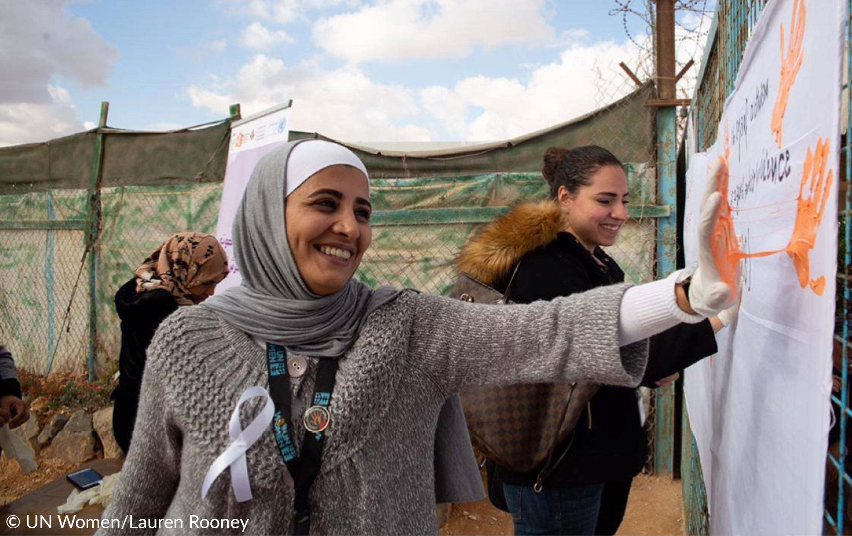
Remember Zonta’s Vision as we celebrate our
40th year of service to Zonta International
Zonta International envisions a world in which women's rights are recognized as human rights and every woman is able to achieve her full potential.
In such a world, women have access to all resources and are represented in decision making positions on an equal basis with men.
In such a world, no woman lives in fear of violence.
©UNICEFMK
www.zonta.org Donate
Notes:
Zonta is committed to meeting Sustainable Development Goal 5 and is working to achieve gender equality and to empower all women and girls.

Slide 6
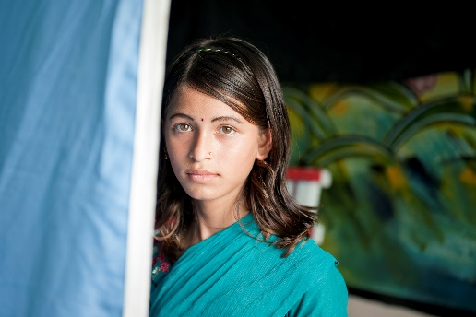
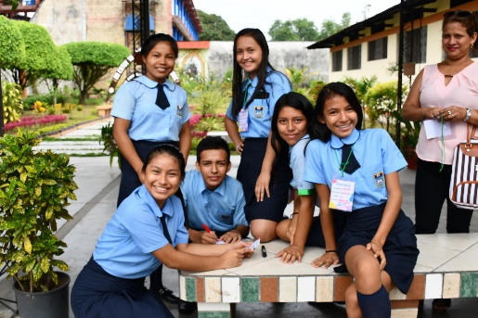
Thank you!
© UNICEF Madagascar/2017/Abela Ralaivita
© UNICEF_UNI159909_Khan
©UNFPA
©UNICEF/2018
Notes:
You can support the ZI Foundation at any time by visiting www,zonta,org and go to the Donate link.
Thank You

